Slide 1
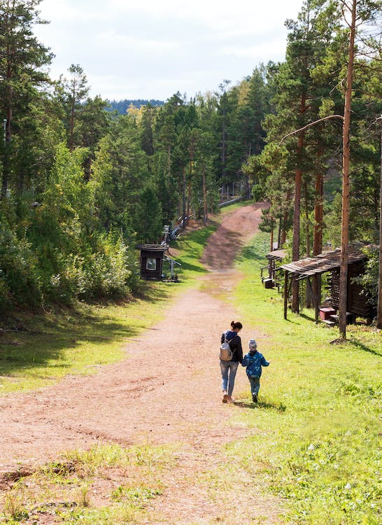
STAG: Solo Parent Talk and Action Group
Meeting 3
Organisers: Grace Halden and Harriet Barratt, Suzy Buckley
Wider team: Natasza Lentner and Ruth Talbot
Notes:
Welcome to the 3rd STAG meeting. My name is Dr Grace Halden and alongside Dr Harriet Barratt and Dr Suzy Buckley we host the Solo Parent Talk and Action Group with assistance from Natasza Lentner and Ruth Talbot.
I know many of you joining us today won’t be solo parents because you’re here to listen to the donor siblings talk which involves the whole donor conception community. Welcome to you all. This is a very informal group and our meetings are designed to share issues and generate ideas for more positive representation and better support for donor assisted families.

Slide 2
Notes:
Just to give a bit of background on the group. We started life as an online Café for the Being Human Festival last year – it became clear that having a space to talk about issues and developments related to donor conception and solo parenting was important, so STAG came from that. We aim to meet every couple of months and every meeting will have a different guest speaker and focus.

Slide 3
Today
Talk from Hayley King Donor Sibling Connections UK group who recently submitted the document 'Our Say: Pre 18 Contact with Donor Siblings' to the HFEA. With Q&A.
1
Update from the Working Group from the publication 'Independent Family Planning: Choosing Solo Parenthood through Gamete or Embryo Donation. A guide for fertility healthcare professionals​’
2
Open floor – where next?
3
Notes:
This session we are focusing on the submission of the document 'Our Say: Pre 18 Contact with Donor Siblings’ to the HFEA and issues relating to donor siblings. This will be led by Hayley King. Towards the latter part of the meeting we there will be a short report on the publication of the 'Independent Family Planning: Choosing Solo Parenthood through Gamete or Embryo Donation. A guide for fertility healthcare professionals​’ booklet. Finally, we will talk about the exciting news that STAG has received funding and how best to use this money. I will say here that if you want to read either document you can find them on my website and a link will be provided in the chat.

Slide 4
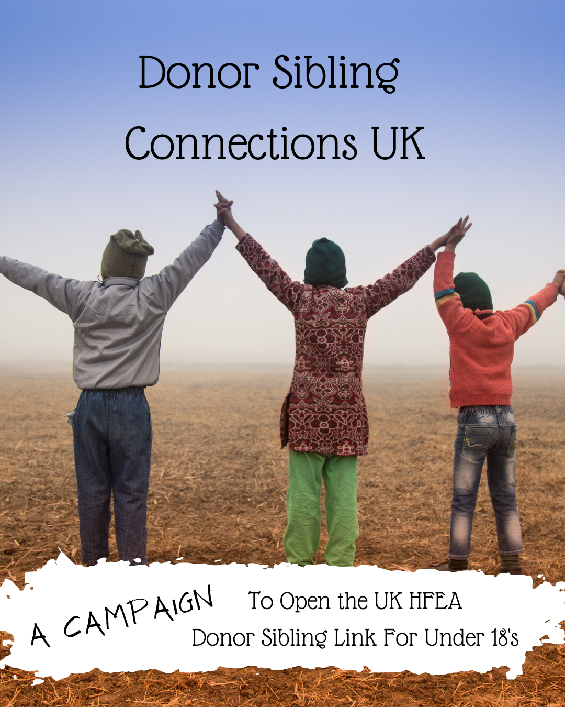
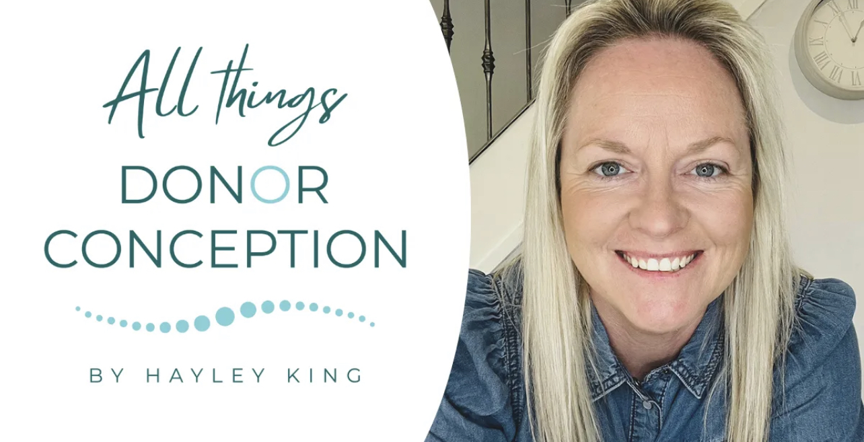
Hayley King
Donor conceived person and mother to donor conceived children.
LGBTQ+ Director at Paths to Parenthub, an online support platform for parents via donor conception
Founder of Donor Sibling Connections UK
Website: All Things Donor Conception.
Notes:
So, let’s get started. Our guest speaker this week is Hayley King who is both a donor conceived person and a mother of donor conceived children. Hayley is real champion for donor conceived families! She is the LGBTQ+ Director at Paths to Parenthub, an online support platform for parents via donor conception, she runs the website All Things Donor Conception and she is the Founder of Donor Sibling Connections UK. Thank you very much for joining us today, Hayley. We will be recording Hayley’s presentation – we will not record the Q&A or the voices of any attendees. The recording will be stopped after the presentation. Ok, Hayley I’ll pass over to you now for your presentation. I’ll be manning the ppt, so just give me a nod when you wish for the slides to change. There will be time for questions at the end of Hayley’s presentation.

Slide 5
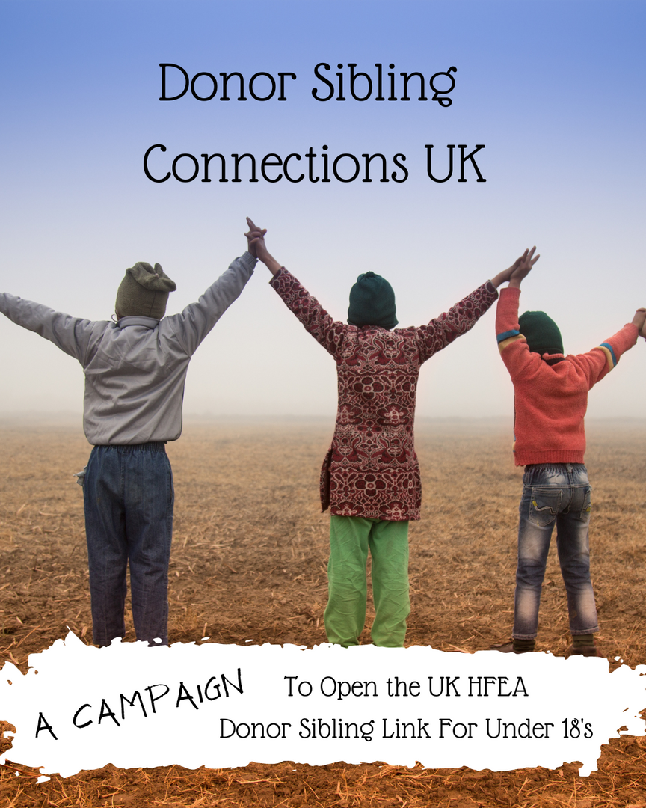
Welcome!
June 9th 2023 8pm
Presentation by the
Donor Sibling Connections UK (DSC-UK) Group
Who we are as a group
Background
What the campaign is about
Why we believe it is a worthy cause.
Actions taken and next steps
Q&A

Slide 6
Who we are ...
Donor Sibling Connections UK (DSC-UK)
Founding Members
Hayley King
Mel Johnson
Dr Grace Halden
Natasza Lentner
Ursula Smyth
Jo Walker
Freya Lyons
Point of Contact
hayley@allthingsdonorconception.com
Find us on facebook, search under groups 'Donor Sibling Connections UK'

Slide 7
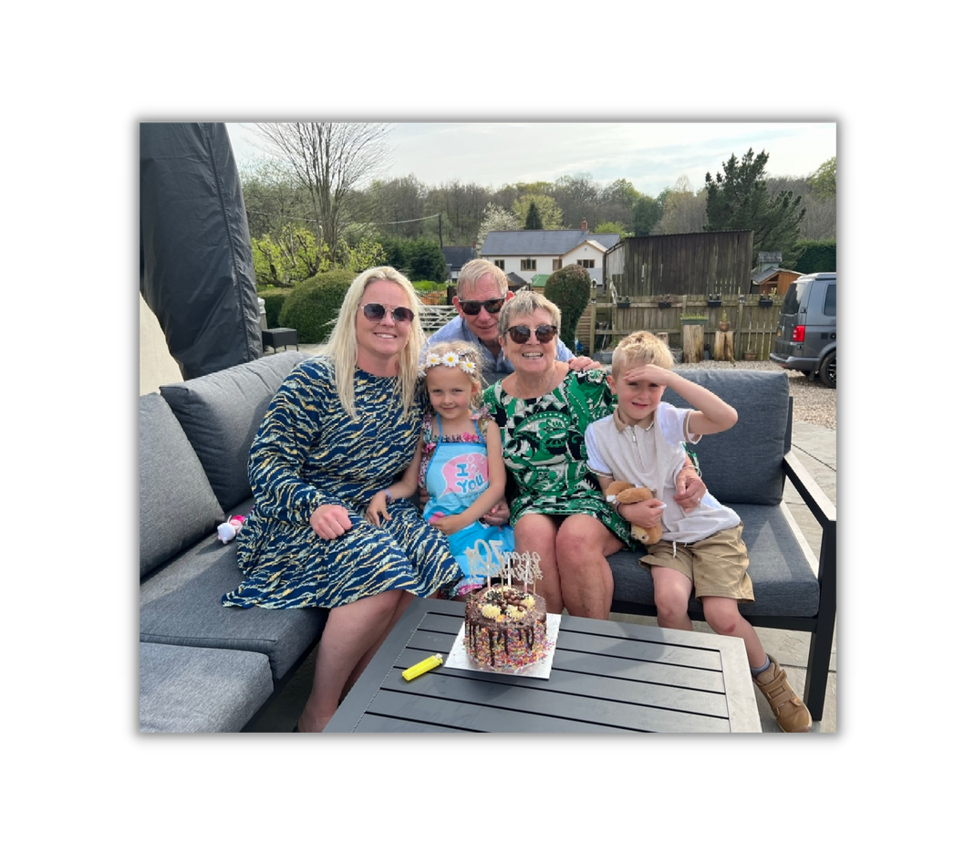
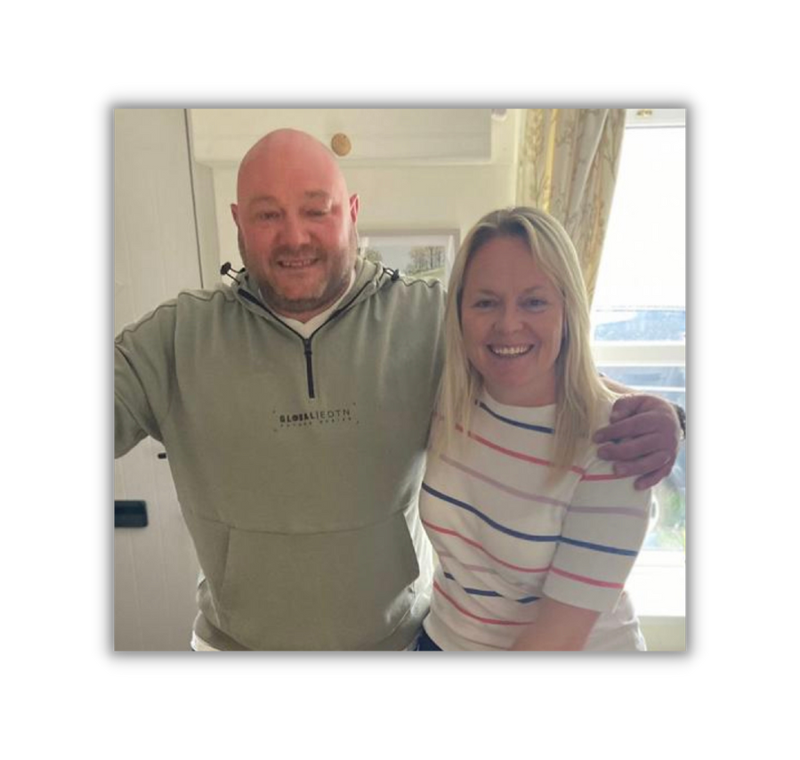
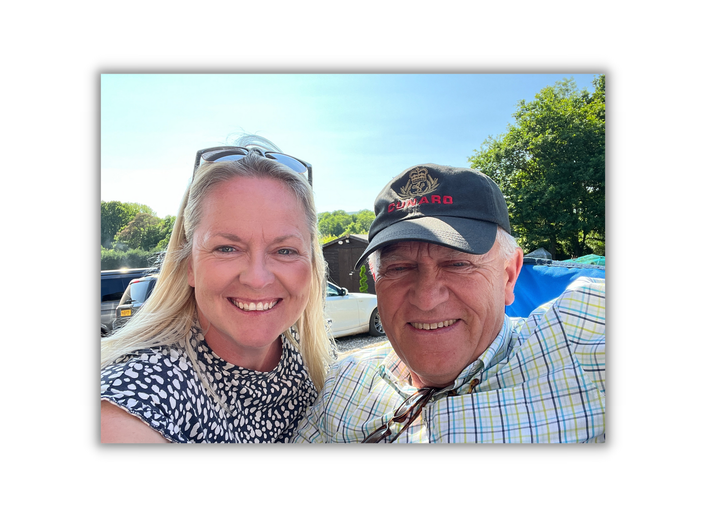
What's
Your Story?

Slide 8
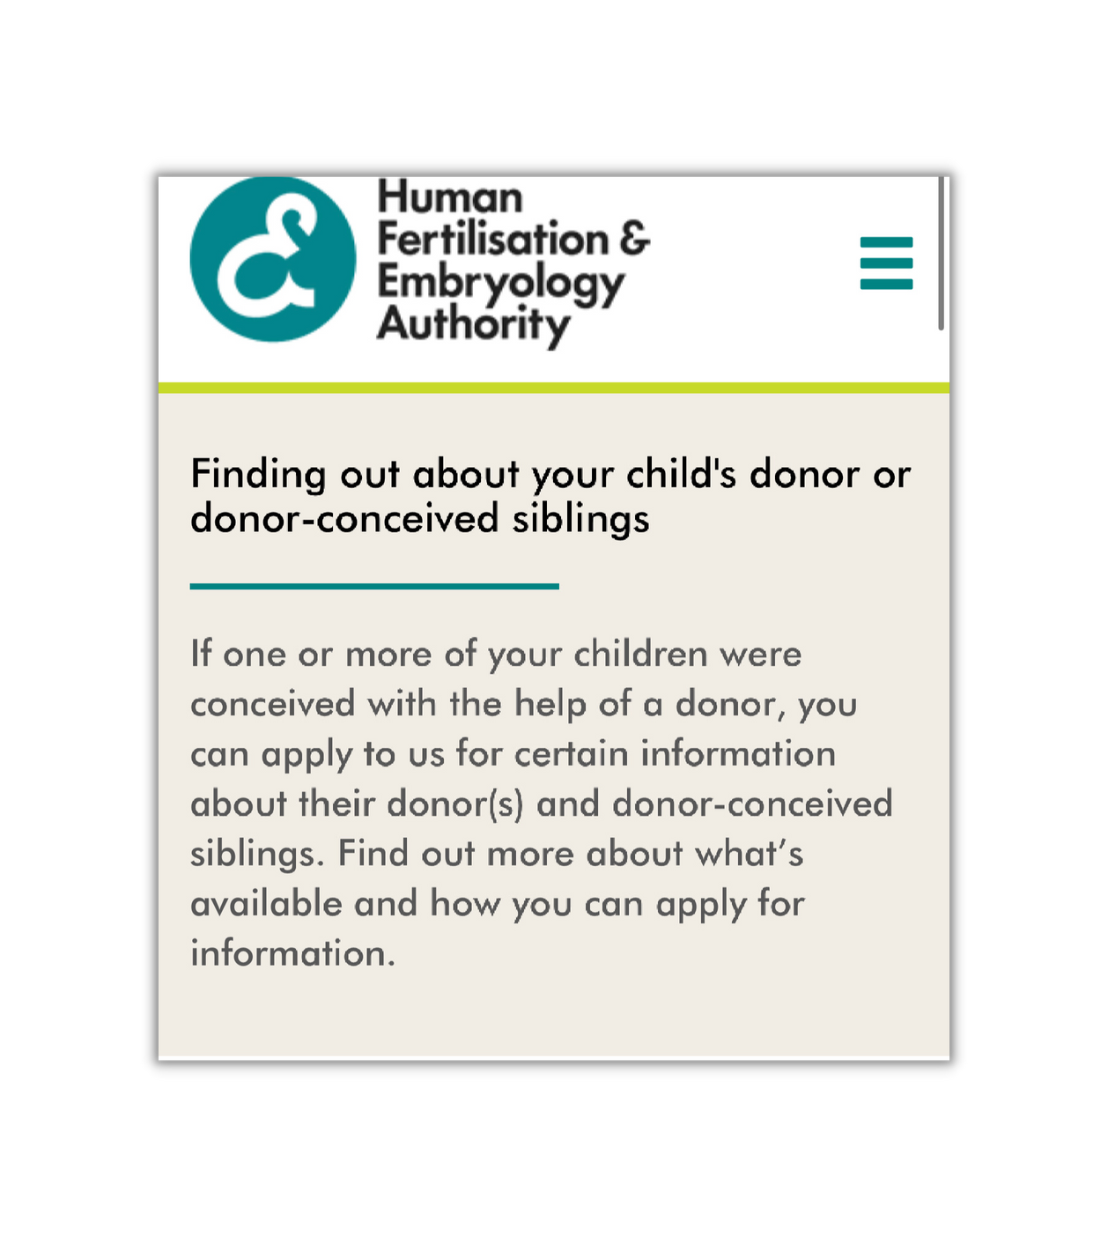
Background
The HFEA from 1991 - Current
(Human Fertilisation Embryology Authority)
What is the existing framework?
The Donor Sibling Link (DSL)
(Uk Siblings ONLY)
For more info see https://www.hfea.gov.uk/

Slide 9
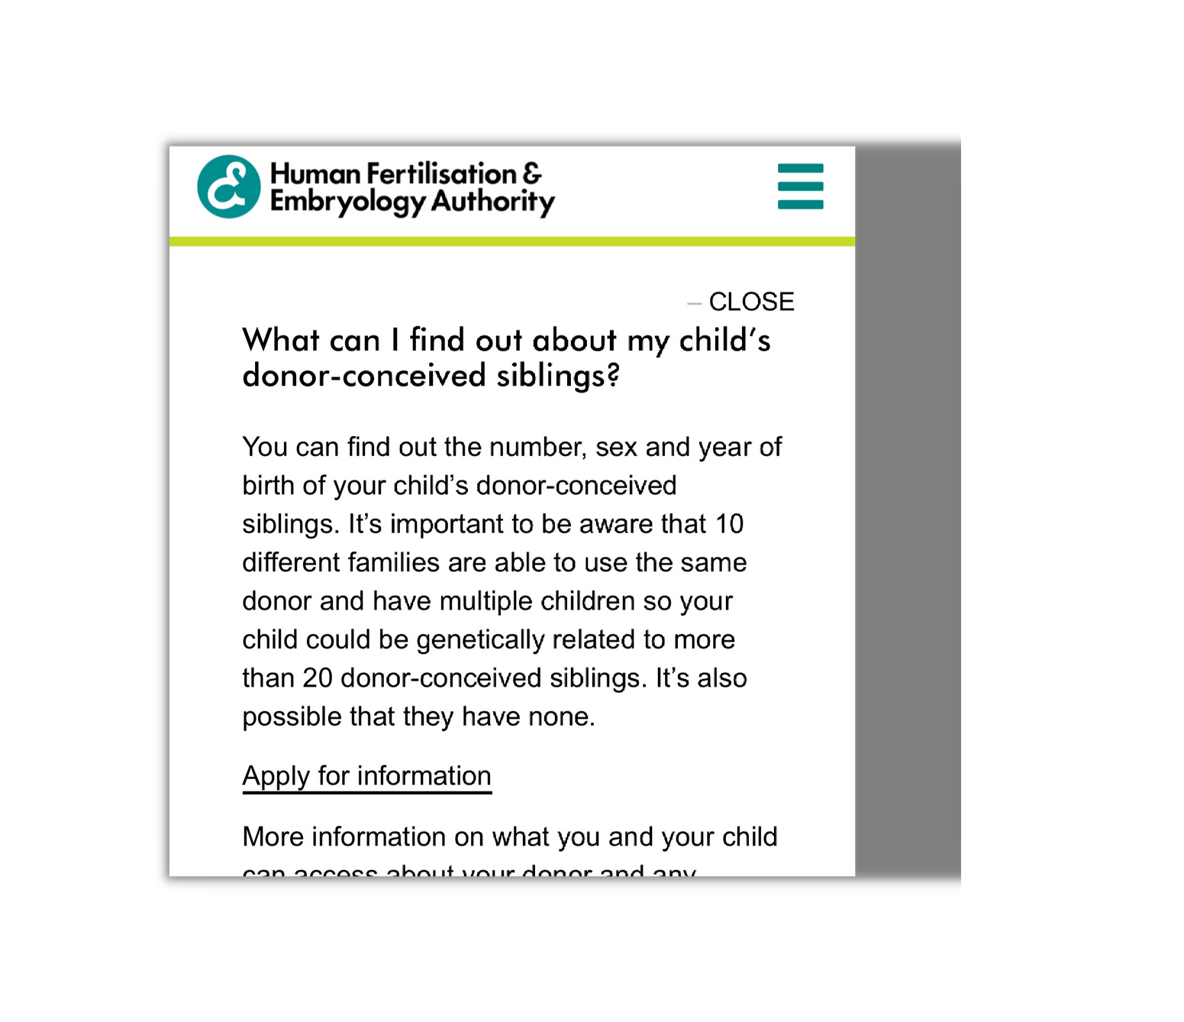
Current Framework
From birth parents can apply for basic, non identifying info about their children's donor siblings. At 16 years donor conceived young people can request this info.
(current wait list from application is around 12 months)
The Donor Sibling Link (DSL) is open from 18 years (release of ID info of siblings on an opt in basis)
(Uk Siblings ONLY)
Exception - At 16 years if a donor conceived young person becomes sexually active they can make a joint application to HFEA (with partner) to see if they are half siblings
For more info see https://www.hfea.gov.uk/

Slide 10
The Campaign
The Donor Siblings Connections UK campaign group was formed at the start of 2023 by a number of UK based parents of donor conceived children who wish to advocate for changes to HFEA legislation; specifically to have the capability to be connected with their children’s UK donor siblings via the UK Donor Sibling Link (DSL) before a child turns 18.
Find us on facebook, search under groups 'Donor Sibling Connections UK'

Slide 11
But Why?
Research shows that increasingly parents of donor conceived children desire to connect with other families who have used the same egg or sperm donor to conceive a child (their children’s donor siblings) (Hertz et al. 2017).
However, current laws in the UK governed by the HFEA prohibit clinics from sharing information even if their is mutual consent to connect (HFEAct, 2008).
Despite the HFEA having donor sibling information stored on their database, due to laws surrounding anonymity, they are unable to release this identifying information until a child turns 18
(The Donor Sibling Link - HFEA).
Find us on facebook, search under groups 'Donor Sibling Connections UK'

Slide 12
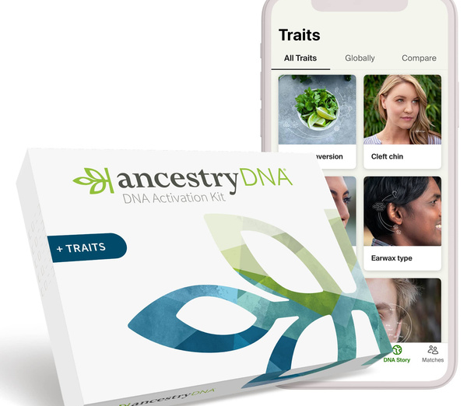
As a result of these restrictions, many parents have resorted to the following unregulated methods to connect with donor sibling families:
Commercial DNA testing (such as AncestryDNA, 23&Me)
Pay for services like the Donor Sibling Registry (DSR) or My Donor Family
Join unofficial Facebook/online groups designed to help match families
Whilst these methods can be successful, some UK parents would like to see the option to connect with other UK based families being achievable in a verified manner via official channels (ie the HFEA DSL).
This is the key aim of this campaign group.
Find us on facebook, search under groups 'Donor Sibling Connections UK'

Slide 13
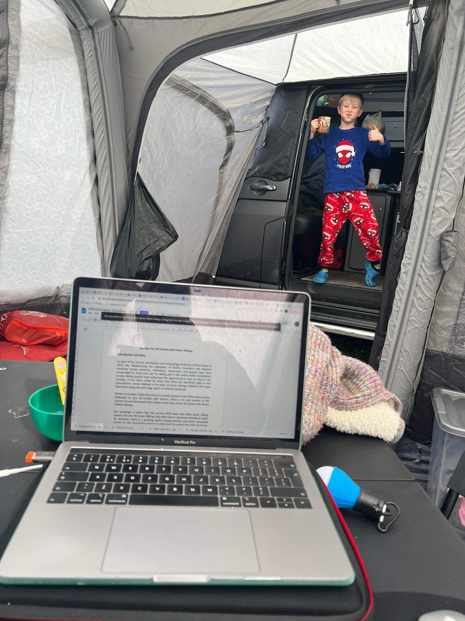
The HFEA Public Consultation
April 2023
DSC-UK Submission
Our Say: Pre 18 Contact with Donor Siblings
Document is available & free to access
A thorough appraisal of the campaign
Outlines research supporting our cause
Find us on facebook, search under groups 'Donor Sibling Connections UK'

Slide 14
Actions to date...
Established a founding group of members
A Facebook group to coordinate and facilitate communication
Group submission to HFEA as part of their wider public consultation
Ongoing discussions with stakeholders including but not limited to -
The ConnecteDNA Project (namely, Dr Leah Gilman)
The Donor Conception Network
Paths to Parenthub (founder Becky Kearns)
LGBT Mummies
The Stork and I (founder Mel Johnson)
Laura Bridgens (Current Co-Chair of the UK Donor Conceived Register)
Members of The British Infertility Counselling Association (BICA).

Slide 15
Next Steps ...
Establish what the HFEA's actual stance is on the existing Donor Sibling Link - as there was no mention of it or indeed about (connecting with) donor siblings from birth in their recent public consultation survey
Invite representatives from the HFEA and other stakeholders to discuss our campaign
Publicise our campaign & linked FB Group
GET YOUR INPUT!

Slide 16
Thank You For Listening...
Now for Q&A Time!
Contacts: hayley@allthingsdonorconception.com
g.halden@bbk.ac.uk
Don't forget to check out the document
'Our Say: Contact With Donor Siblings'
(link will be made available)
Find us on facebook, search under groups 'Donor Sibling Connections UK'

Slide 17
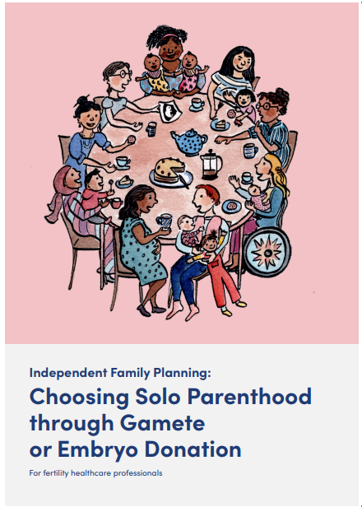
This project seeks to produce a booklet on solo motherhood by choice to be shared with fertility clinics throughout the United Kingdom. The objective of this booklet is to highlight to industry professionals the lived experiences of solo mothers at the stages of family planning, choosing donor gametes, embarking on the conception journey, pregnancy, and birth.
Notes:
For those who are not solo parents, you may wish to exit here as you might find this portion not as significant but you are welcome to stay. If you are leaving us, thank you so much for coming.
I want to now give an overview of the publication of the Independent Family Planning. This booklet was designed to be shared with fertility clinics throughout the United Kingdom. The objective of this booklet is to highlight to industry professionals the lived experiences of solo mothers at the stages of family planning, choosing donor gametes, embarking on the conception journey, pregnancy, and birth. This booklet was funded by the Wellcome Trust and was peer reviewed by a team of 4 industry experts. The booklet also had the DCN and Bourn Hall Clinic as consultants.

Slide 18
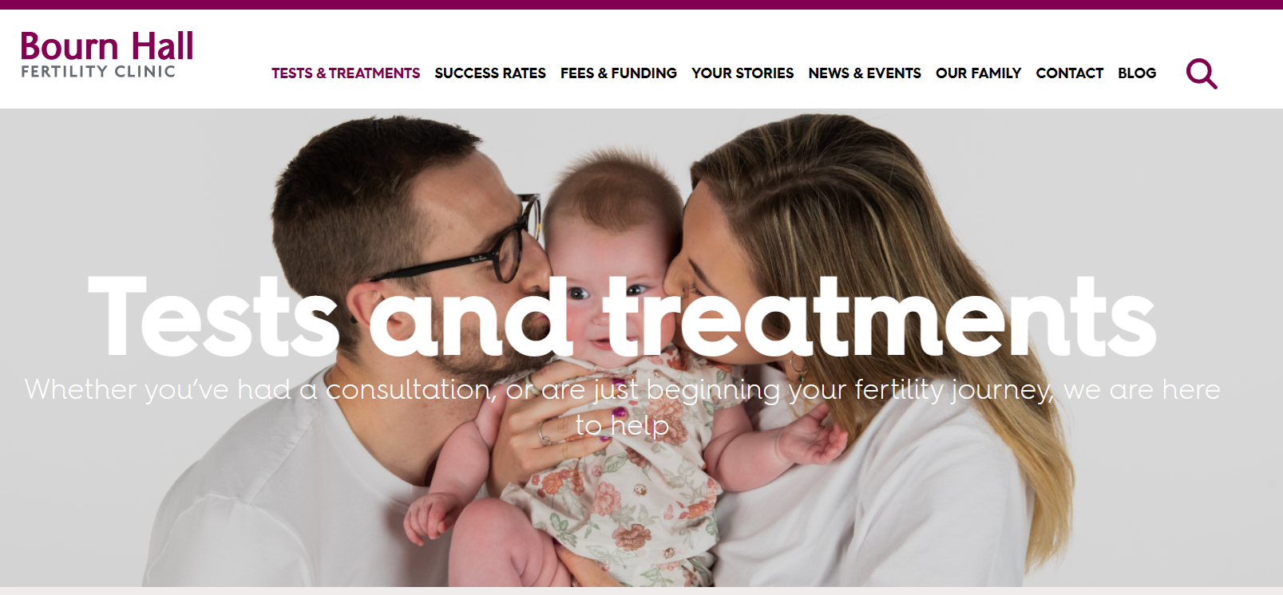
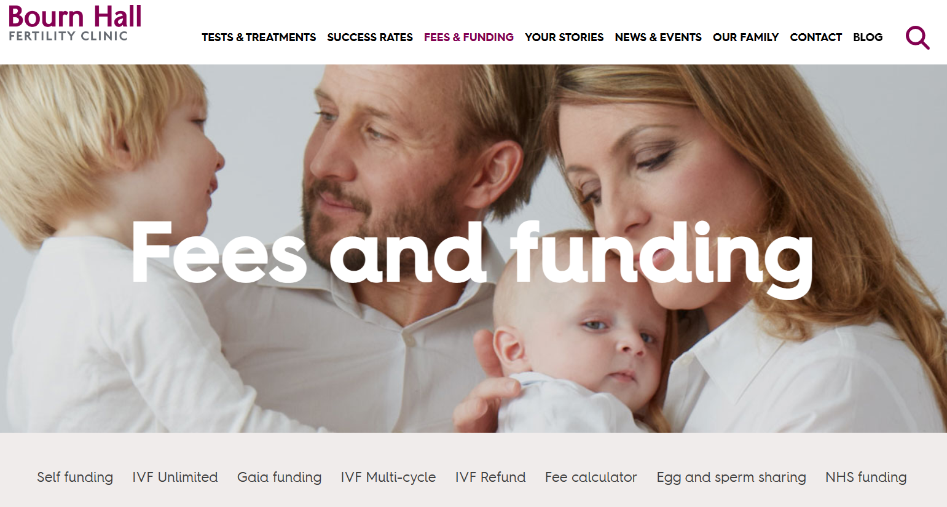
Do clinics understand their patients?
Notes:
The booklet was produced to respond to a growing sense of frustration issued by many in the community that clinics did not have a bespoke approach to treating solo patients. Concern that clinics were not shaping care and policy in a differentiated way was shared by many solo parents but we can also see a lack of proper attention on websites.

Slide 19
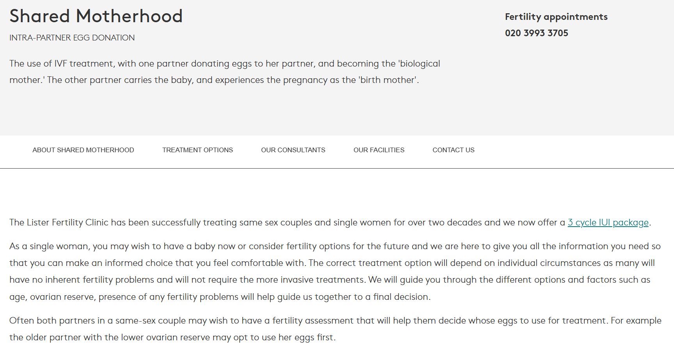
Notes:
Here is one example in which a solo parent is shoehorned into an existing webpage as an afterthought. This page is about shared motherhood with a focus on intra-partner egg donation and yet randomly we have the inclusion of ‘single woman’ twice. Lack of representation or inadequate representation is commonplace as is a lack of bespoke care within clinics – for example, testimony in which solo women report being called into consultations with their partner. Furthermore, we also heard from patients who felt that resources, consultations, and care often speak about issues, challenges, and treatment options for couples.

Slide 20
Medicine as engaging communities
How can medical practitioners engage not just with individuals but with a community?
Rethinking the consultation process and destabilising the hierarchy
Notes:
The Wellcome Trust funded this project because it recognized the important of destablising the hierarchy in healthcare – meaning that we need clinics not just to offer consultations with us, but for the community to consult with the clinics and advise them on how to better support patients.

Slide 21
THE WORKING GROUP
Grace Halden
Senior Lecturer researching donor conception (Fellow: Royal Society of Public Health)
Mel Johnson
Qualified life coach and founder of The Stork and I
Shalaka Kamerkar
Senior Project Manager in Medical Communications
Nancy Milligan
Medical writer
Genevieve Roberts
Author of Going Solo: My choice to become a single mother using a donor (2019)
Dr Rebecca Ward
Patient Services Associate & MBChB graduate
Notes:
The working group tasked with designing the contents of the booklet are all solo women on the solo parenthood pathway.

Slide 22
3 stage approach
Lived-experience
Peer reviewed
Supported by research
Notes:
Our approach was to centralized lived-experience by solo patients, present contemporary research, and have this work preapproved by peers.

Slide 23
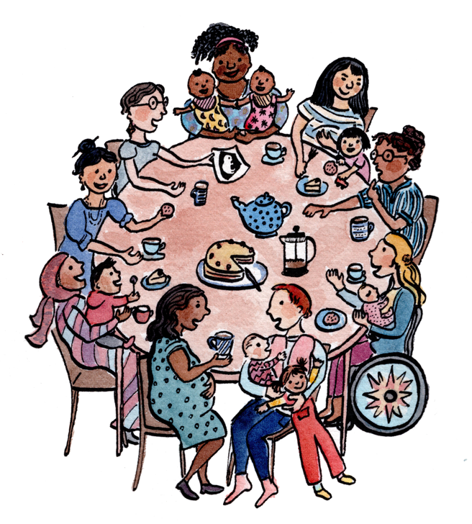
Imogen Foxell
Illustrator
Alice Smith
Digital Designer
Notes:
Our design team are also solo parents. Imogen Foxell illustrated this booklet while on maternity leave and Alice Smith designed the presentation of the booklet.

Slide 24
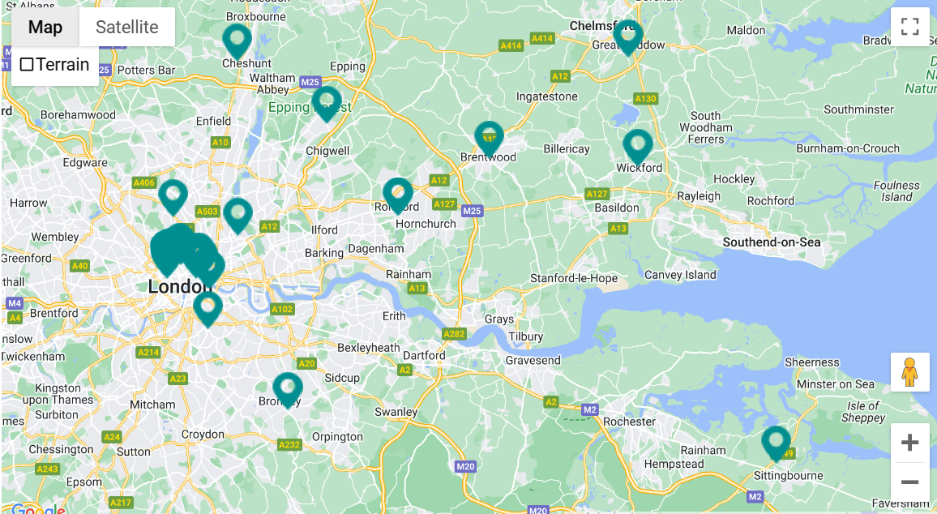
Dissemination
Shared with the Donor Conception Network, Single Parents Rights UK, academic institutions with research interests in donor conception including University College London
WAVE 1: Shared with 41 clinics for ‘wave 1’ radius 25 miles from Bourn Hall
Hard copies will be posted out on the 22nd of June
Notes:
So far, the booklet has been received by the DCN, the Single Parents Rights UK group, interested academics and their institutions and other parities like BioNews. It has been shared with 41 clinics with hard copies going out this month. The next stage is to complete the whole UK distribution which will happen in the next few weeks.

Slide 25
What next?
A second booklet. Focus?
Similar booklet designed for treatment on the NHS (includes GP)
Booklet for maternity care in private and state care
Booklet for doulas and other birth support practitioners
Other…
Notes:
I will welcome questions if there are any but want to flag that the next step for this project is to think about what a second booklet might look like. Do we have thoughts on this?

Slide 26
Contacts
Hayley King
Email: hayley@allthingsdonorconception.com
Website: www.allthingsdonorconception.com
Grace Halden
Email: g.Halden@bbk.ac.uk
Website: www.drgracehalden.com

Slide 27
Resources
'Independent Family Planning: Choosing Solo Parenthood through Gamete or Embryo Donation. A guide for fertility healthcare professionals​’ here
'Our Say: Pre 18 Contact with Donor Siblings’ here

